Slide 1
Object Detection:
YOlov5 vs yolov8
Group G: Justin Arias, Kaitlyn Cady, Gerin Fajardo, Matthew Romero

Slide 2
Table of contents
01
motivation/introduction
02
State of the arts
03
system
04
Performance

Slide 3
01
motivation/intro
T
1

Slide 4

motivation
Real-World Relevance
Human detection is vital for applications in robotics, surveillance, & autonomous systems
Edge devices like the Jetson Nano enable real-time, low-power solutions
Problem
Limited computational resources demand efficient models for accurate & fast detection
Objective
Compare YOLOv5 & YOLOv8 to determine the best-suited model for human detection
T
1

Slide 5
02
State of the arts
T
2

Slide 6
State of the arts
study | Models tested | device | Key findings
Benchmarking Models on Edge Devices | YOLOv8 | Jetson Nano | YOLOv8 excels in speed but loses accuracy in low-quality input
Human Detection Using YOLOv5 | YOLOv5 | Jetson Nano | YOLOv5 provides robust detection under environmental variability
Integrated YOLOv5 for Search & Rescue | YOLOv5, YOLOv8 | UAV & Nano | YOLOv5 outperforms YOLOv8 in maintaining detection confidence
T
4

Slide 7
03
Our system
T
3

Slide 8
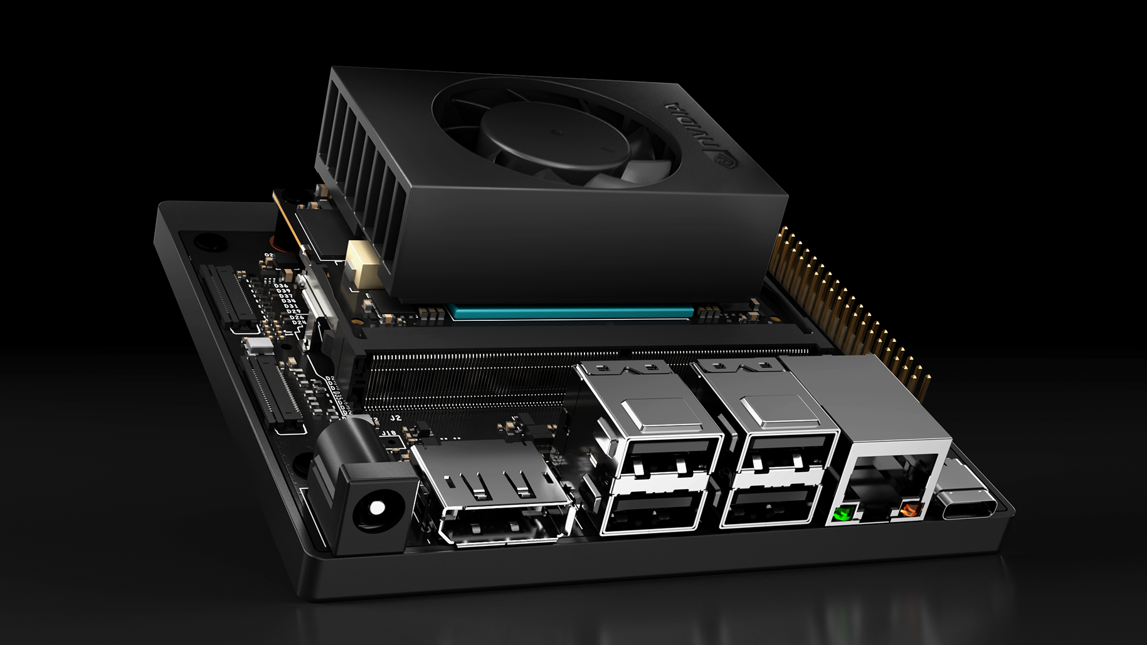
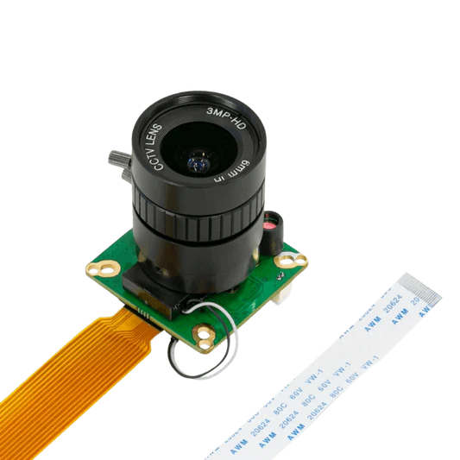
Our system
Hardware Setup
Jetson Orin nano Developer Kit
ArduCam Raspberry Pi HQ Camera (Connected via USB)
Camera Running at 1080p @ 30FPS
Monitor, Keyboard, & Mouse
Software and Models
YOLOv5 and YOLOv8 Frameworks for Human Detection
OpenCV for Capturing Images
Roboflow People_Detection Dataset
T
1

Slide 9
04
Performance
T
4

Slide 10
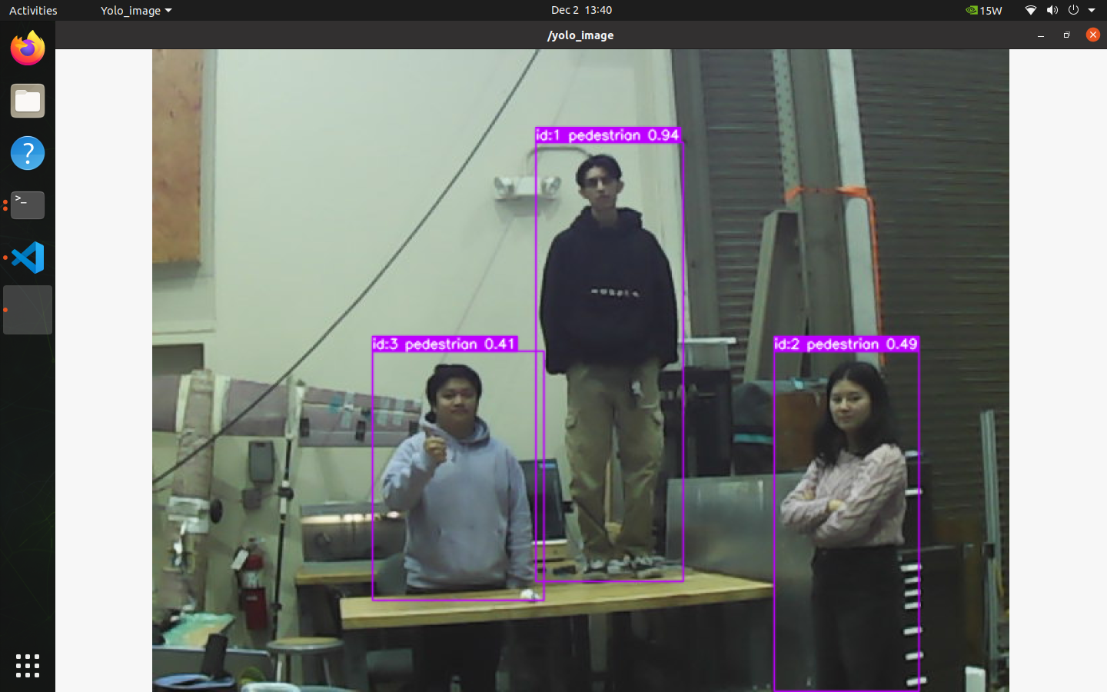
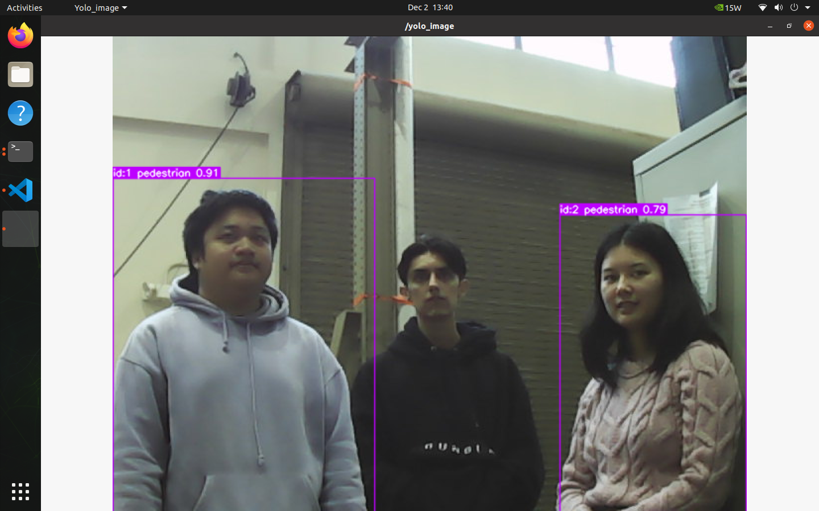
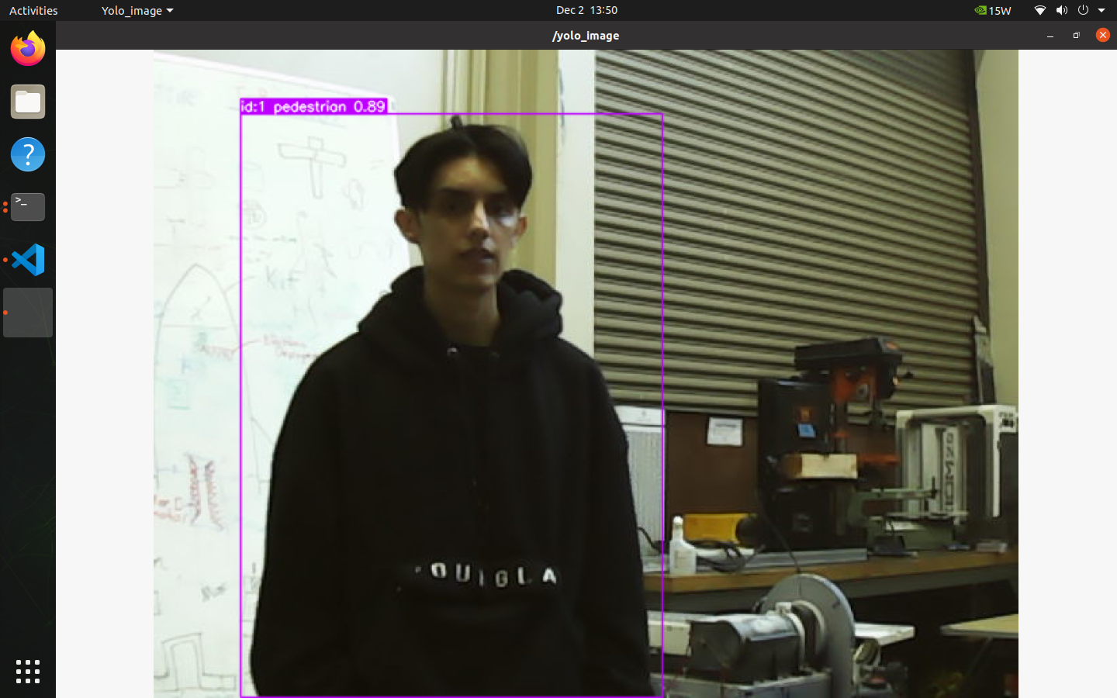
Yolov5 tests
T
1

Slide 11
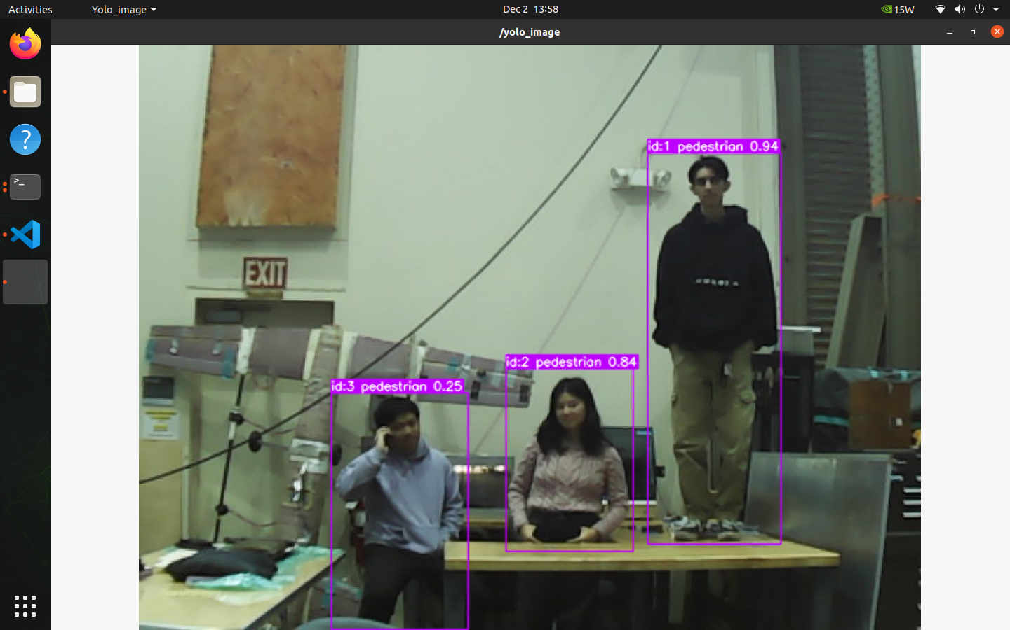
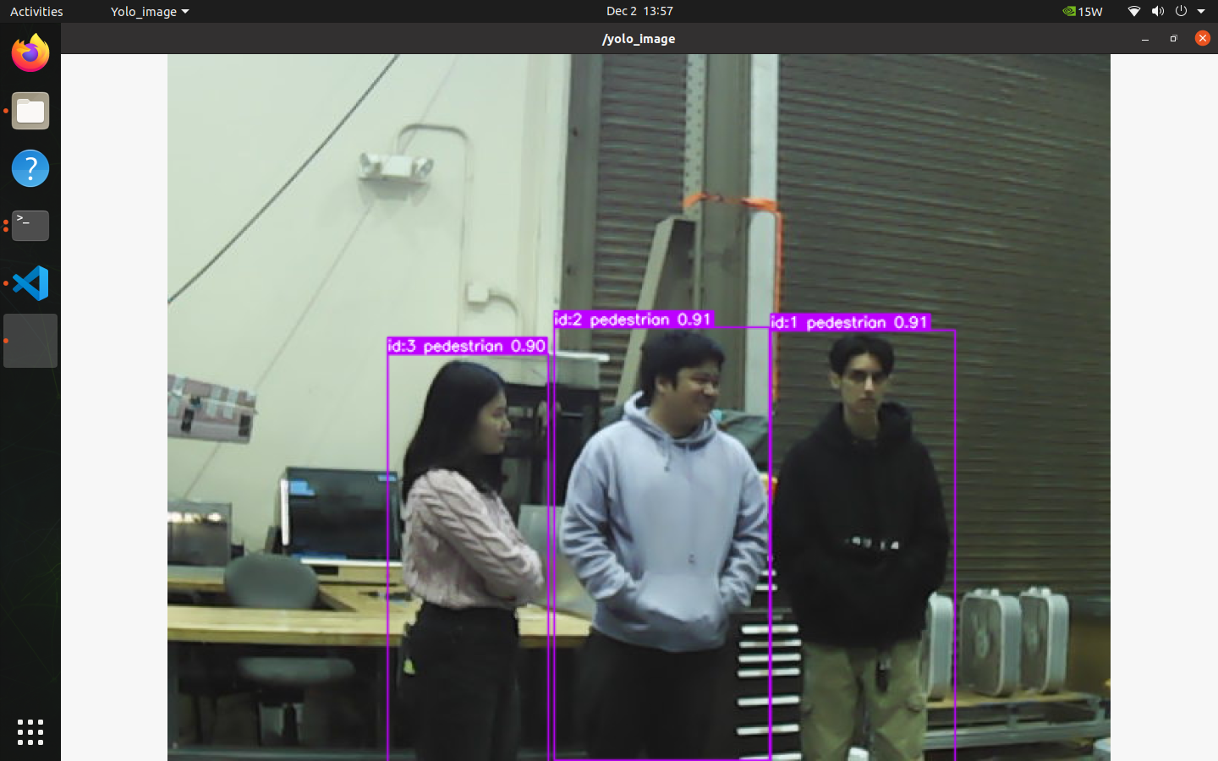
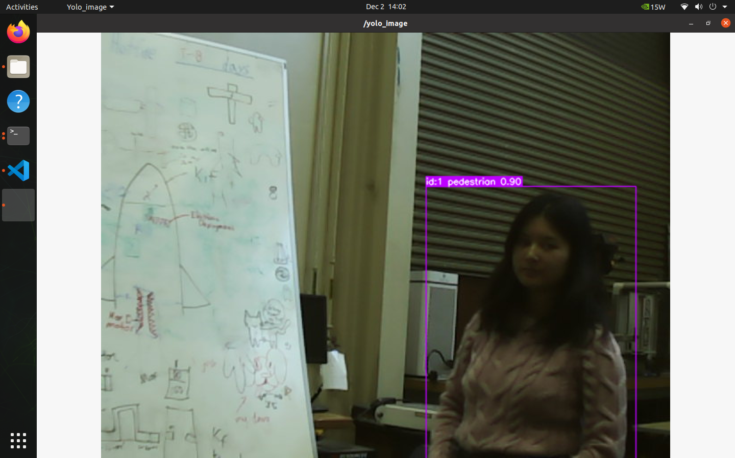
Yolov8 tests
T
1

Slide 12
Performance metrics
distance | Yolov5 Average confidence | Yolov8 Average confidence | % Difference
5 ft | 0.84 | 0.91 | 8%
10 ft | 0.87 | 0.92 | 5.58%
15 ft | 0.89 | 0.90 | 1.117%
Metrics
Detection Confidence Scores at 3 Distances
Distances: 5 ft, 10 ft, 15 ft
Confidence Score: Model’s Certainty about its detection being correct.
Higher Confidence suggests better detection performance at different distances
T
1
Notes:
For performance metrics We did multiple trials to test detection confidence which indicates how certain the model is about identifying humans. These numbers are averages of these trials at 5, 10, and 15 ft

Slide 13
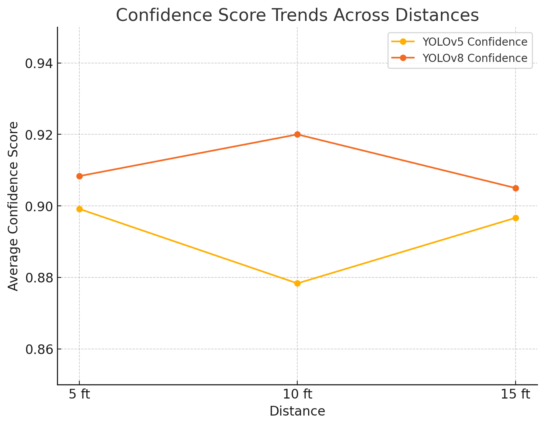
Confidence score trends
Analysis
YOLOv8 consistently outperformed YOLOv5 across all distances
Smallest confidence difference observed at 5 ft, with YOLOv8 achieving slightly higher accuracy
Both models show an increase in confidence at farther distances
T
1
Notes:
We measured detection confidence, which indicates how certain the model is about identifying humans."

Slide 14
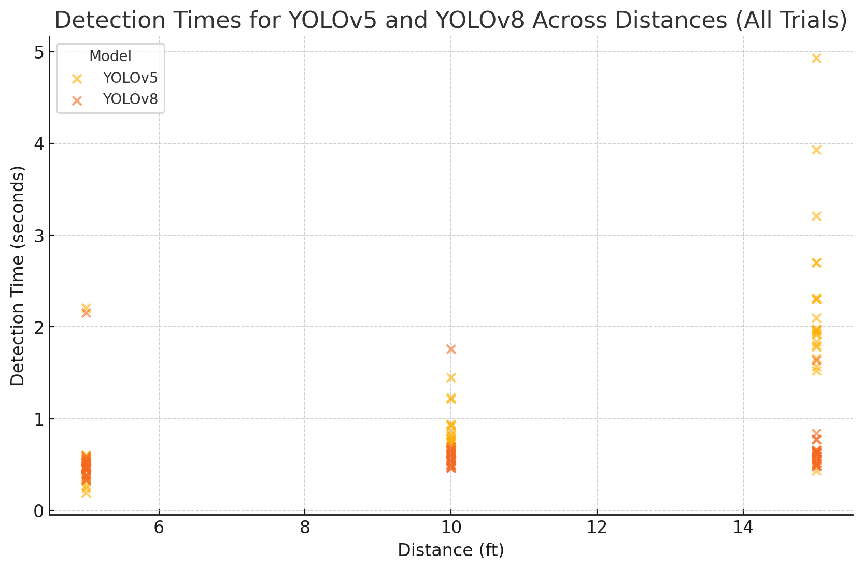
detection times
What is Detection Time?
Time it takes for the system to detect a human after they enter the frame
Measured across multiple trials at varying distances for consistency
Key Observations
YOLOv5
5ft: 272.6 ms
10 ft: 549.0 ms
15 ft: 1193.0 ms
More variability in detection times
YOLOv8
5ft: 209.5 ms
10ft: 307.5ms
15ft: 362.5ms
Less variability in detection times
YOLOv8 outperforms YOLOv5 in detection efficiency, particularly at greater distances
T
1
Notes:
We measured detection confidence, which indicates how certain the model is about identifying humans."

Slide 15
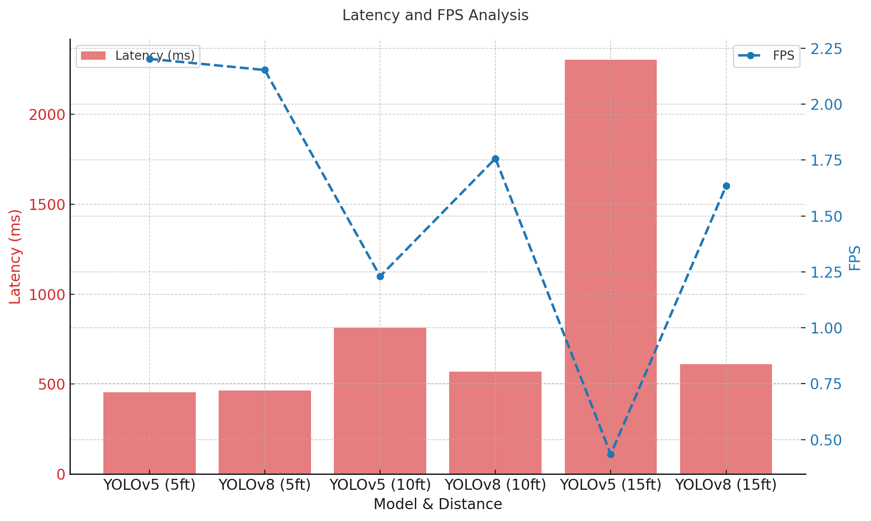
FPS and Latency Analysis
What is FPS & Latency?
FPS: Number of frames processed by the system per second
Latency: Time delay (in milliseconds) for the system to process and detect object in each frame
Key Observations
Latency Analysis
YOLOv5 exhibits higher latency values compared to YOLOv8
Latency indicates slower performance for objects farther from the camera
FPS Analysis
YOLOv5 has lower FPS due to its higher latency, affecting real-time performance
YOLOv8 maintains higher FPS, showing improved suitability for real-time applications
T
1
Notes:
We measured detection confidence, which indicates how certain the model is about identifying humans."

Slide 16
conclusion
YOLOv8 demonstrates superior performance in both latency and confidence metrics, showcasing faster detection and more consistent accuracy across varying distances.
YOLOv5 still proves reliable at longer ranges, maintaining strong confidence scores but slightly slower processing times.
Trade-offs exist between speed and accuracy: YOLOv8 is better suited for real-time applications, while YOLOv5 may excel in tasks prioritizing detection reliability at distance.
Both models show room for improvement in handling edge cases and maintaining performance consistency across environmental variations.
T
1
Notes:
We measured detection confidence, which indicates how certain the model is about identifying humans."

Slide 17
References
[1] Smith, J., Lee, K., & Tran, H. (2023).
"Benchmarking YOLO Models on Edge Devices: A Performance Study."
Journal of Edge Computing Research, 15(2), 45-60.
[2] Patel, R., Zhang, M., & El-Sayed, N. (2022).
"Robust Human Detection Using YOLOv5 on Edge Platforms."
IEEE Conference on Smart Systems, pp. 123–129.
[3] Green, D., O’Connor, P., & Singh, A. (2023).
"Comparing YOLOv5 and YOLOv8 in UAV-Based Search and Rescue Operations."
International Journal of Robotics and Automation, 29(4), 67-79.
T
1
Notes:
We measured detection confidence, which indicates how certain the model is about identifying humans."

